Slide 3
Studying The Bible
It is essential for spiritual growth
It is essential for spiritual maturity
It is essential for spiritual effectiveness

Slide 4
The more that the Bible is in us, the less that the world will be in us
The more that the Bible is in us, the more confident, successful and pleasing to God we will be

Slide 5
Read=Study=Read=Study=Read=Study=Read=Study=Read=Study

Slide 6
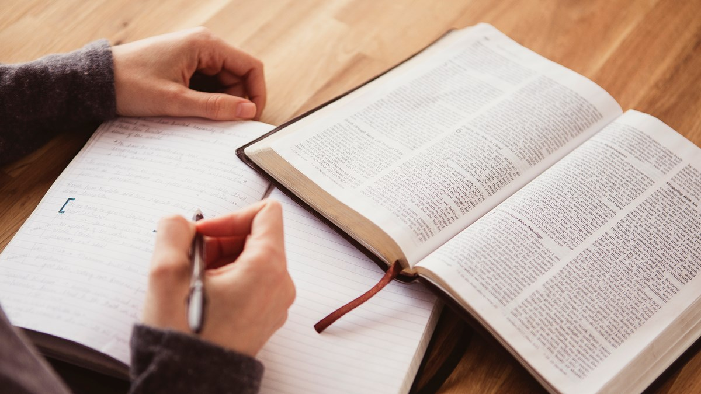
Acts 17:11 “Now these were more noble-minded than those in Thessalonica, for they received the word with great eagerness, examining the Scriptures daily to see whether these things were so.
The Concept of “Studying the Bible”

Slide 7
1 Thessalonians 2:13 “For this reason we also constantly thank God that when you received the word of God which you heard from us, you accepted it not as the word of men, but for what it really is, the word of God, which also performs its work in you who believe.”
The Concept of “Studying the Bible”

Slide 8
Nehemiah 8:8 “They read from the book, from the law of God, translating to give the sense so that they understood the reading.”
The Concept of “Studying the Bible”

Slide 9
Matthew 4:4 “ But He answered and said, “It is written, ‘Man shall not live on bread alone, but on every word that proceeds out of the mouth of God.’”
The Concept of “Studying the Bible”
The Bible is a Divine Book
You must approach the Bible unlike any other book

Slide 10
Matthew 4:4 “ But He answered and said, “It is written, ‘Man shall not live on bread alone, but on every word that proceeds out of the mouth of God.’”
The Concept of “Studying the Bible”

Slide 11
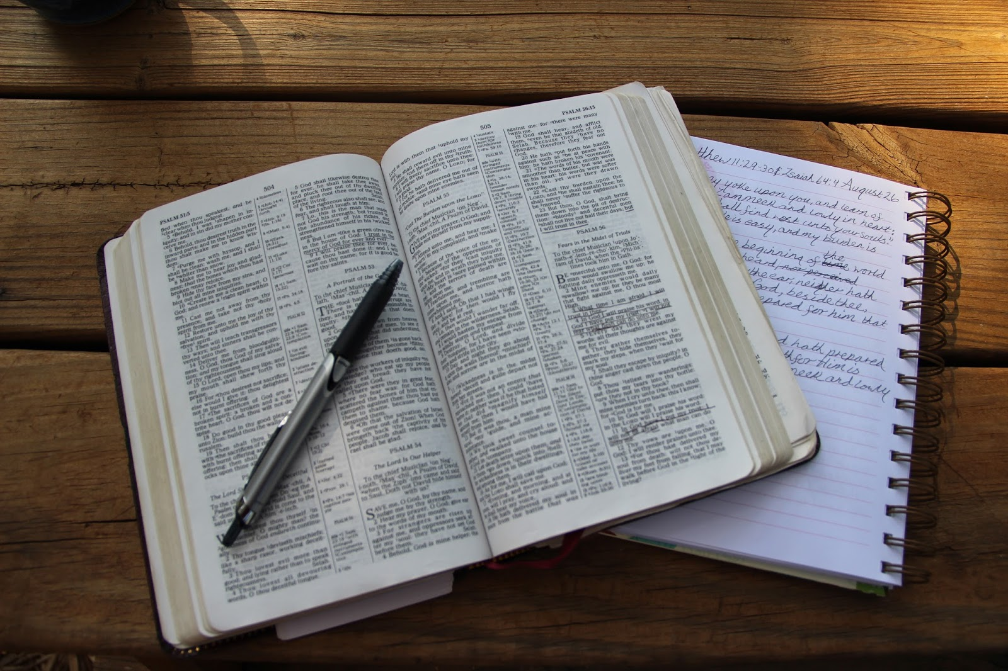
Gal 3:16 “Now the promises were spoken to Abraham and to his seed. He does not say, “And to seeds,” as referring to many, but rather to one, “And to your seed,” that is, Christ.
Observation
See
Every single word is important
Singular/Plurality of a word

Slide 12
Observation
Matthew 22:32 “I Am the God of Abraham, and the God of Isaac, and the God of Jacob. God is not the God of the dead but of the living.”
Every single word is important
Tense of a word

Slide 13
Observation
John 14:3 “If I go and prepare a place for you, I will come again and receive you to Myself, that where I am, there you may be also.”
Every single word is important
Tense of a word

Slide 14
MT 18:26 So the slave fell to the ground and prostrated himself before him, saying, ‘Have patience with me and I will repay you everything.’
Observation
Every single word is important
MT 18:29 So his fellow slave fell to the ground and began to plead with him, saying, ‘Have patience with me and I will repay you.”
Repeated Words

Slide 15
Hebrews 10:22-24 let us draw near with a sincere heart in full assurance of faith, having our hearts sprinkled clean from an evil conscience and our bodies washed with pure water. ²³ Let us hold fast the confession of our hope without wavering, for He who promised is faithful; ²⁴ and let us consider how to stimulate one another to love and good deeds,
Observation
Every single word is important
Repeated Words

Slide 16
Acts 1:1-6 “The first account I composed, Theophilus, about all that Jesus began to do and teach, ² until the day when He was taken up to heaven, after He had by the Holy Spirit given orders to the apostles whom He had chosen. 3 To these He also presented Himself alive after His suffering, by many convincing proofs, appearing to them over a period of forty days and speaking of the things concerning the kingdom of God. ⁴ Gathering them together, He commanded them not to leave Jerusalem, but to wait for what the Father had promised, “Which,” He said, “you heard of from Me; ⁵ for John baptized with water, but you will be baptized with the Holy Spirit not many days from now.” ⁶ So when they had come together, they were asking Him, saying, “Lord, is it at this time You are restoring the kingdom to Israel?”
Observation
Every single word is important
Pronouns

Slide 17
Acts 1:1-6 “The first account I composed, Theophilus, about all that Jesus began to do and teach, ² until the day when He was taken up to heaven, after He had by the Holy Spirit given orders to the apostles whom He had chosen. 3 To these He also presented Himself alive after His suffering, by many convincing proofs, appearing to them over a period of forty days and speaking of the things concerning the kingdom of God. ⁴ Gathering them together, He commanded them not to leave Jerusalem, but to wait for what the Father had promised, “Which,” He said, “you heard of from Me; ⁵ for John baptized with water, but you will be baptized with the Holy Spirit not many days from now.” ⁶ So when they had come together, they were asking Him, saying, “Lord, is it at this time You are restoring the kingdom to Israel?”
Observation
Every single word is important
Pronouns

Slide 18
Mark 1:22 “And they were amazed at His teaching; for He was teaching them as one having authority, and not as the scribes.”
Observation
Every single word is important
Mark 4:41 “And they became very much afraid and said to one another, ‘Who then is this, that even the wind and the sea obey Him?’
Reactions
Mark 6:51 “And He got into the boat with them, and the wind stopped; and they were greatly astonished.”

Slide 19
Observation
Every single word is important
Verbs
Genesis 1

Slide 20
Observation
Every single word is important
Flee
Action words
Fight
Watch
Pay attention

Slide 21
Heb 11:24-28 By faith Moses, when he had grown up, refused to be called the son of Pharaoh’s daughter, ²⁵ choosing rather to endure ill-treatment with the people of God than to enjoy the passing pleasures of sin, ²⁶ considering the reproach of Christ greater riches than the treasures of Egypt; for he was looking to the reward. ²⁷ By faith he left Egypt, not fearing the wrath of the king; for he endured, as seeing Him who is unseen. ²⁸ By faith he kept the Passover and the sprinkling of the blood, so that he who destroyed the firstborn would not touch them.
Observation
Every single word is important
Themes

Slide 22
Heb 11:24-28 By faith Moses, when he had grown up, refused to be called the son of Pharaoh’s daughter, ²⁵ choosing rather to endure ill-treatment with the people of God than to enjoy the passing pleasures of sin, ²⁶ considering the reproach of Christ greater riches than the treasures of Egypt; for he was looking to the reward. ²⁷ By faith he left Egypt, not fearing the wrath of the king; for he endured, as seeing Him who is unseen. ²⁸ By faith he kept the Passover and the sprinkling of the blood, so that he who destroyed the firstborn would not touch them.
Observation
Every single word is important
Themes

Slide 23
Observation
Every single word is important
Psalms 119:18 “Open my eyes, that I may behold wonderful things from Your law.”
To help you, read slowly

Slide 24
Interpretation
Understand
John 8:31-32 So Jesus was saying to those Jews who had believed Him, “If you continue in My word, then you are truly disciples of Mine; and you will know the truth, and the truth will make you free.”
If we can’t understand the Bible the same that means:
God can’t write
The Bible has no consistent meaning
Ephesians 5:17 “So then do not be foolish, but understand what the will of the Lord is.”

Slide 25
Interpretation
Psalms 98:8 “Let the rivers clap their hands, Let the mountains sing together for joy”
The Four
w
Who
What
When
Why

Slide 26
Interpretation
Four Steps of Interpretation:
1. Let Scripture interpret Scripture
2. Let context interpret Scripture
3. Let the Intent interpret Scripture
4. Let the clear interpret the obscure

Slide 27
Application
What do you do with this?

Slide 28
Observation
See it
Interpretation
Understand it
Application
Do it
The goal is not more knowledge, but becoming more like Jesus

